Slide 1

Adobe Analytics Challenge 2020
Team Name: GoldenBears
Team Members: Annais, Samantha, Jackie

Slide 2




Meet our team
Jackie Hu
UC Berkeley
Master of Information Mgmt & Systems ‘22
Samantha Carr
UC Berkeley
Master of Information Mgmt & Systems ‘22
Annais Paetsch
UC Berkeley
Master of Information Mgmt & Systems ‘22

Slide 3
About our process
Goals
Starting with initial data exploration, follow a trail of data-informed questions and hypotheses based off findings in the analytics tool.
Understand limitations within the data, and know when additional research and data would be required.
Identify specific areas of focus and priorities for the Nike team, provide recommendations based on that.
Scope
We focused on the 2020 calendar year through September in China market.
We also narrowed analysis to Nike Web Data only.
Notes:
Following a trail of questions based off signals in the data
Data is a starting point for informing our process
Be specific with findings and recommendations
Add limitation slide

Slide 4
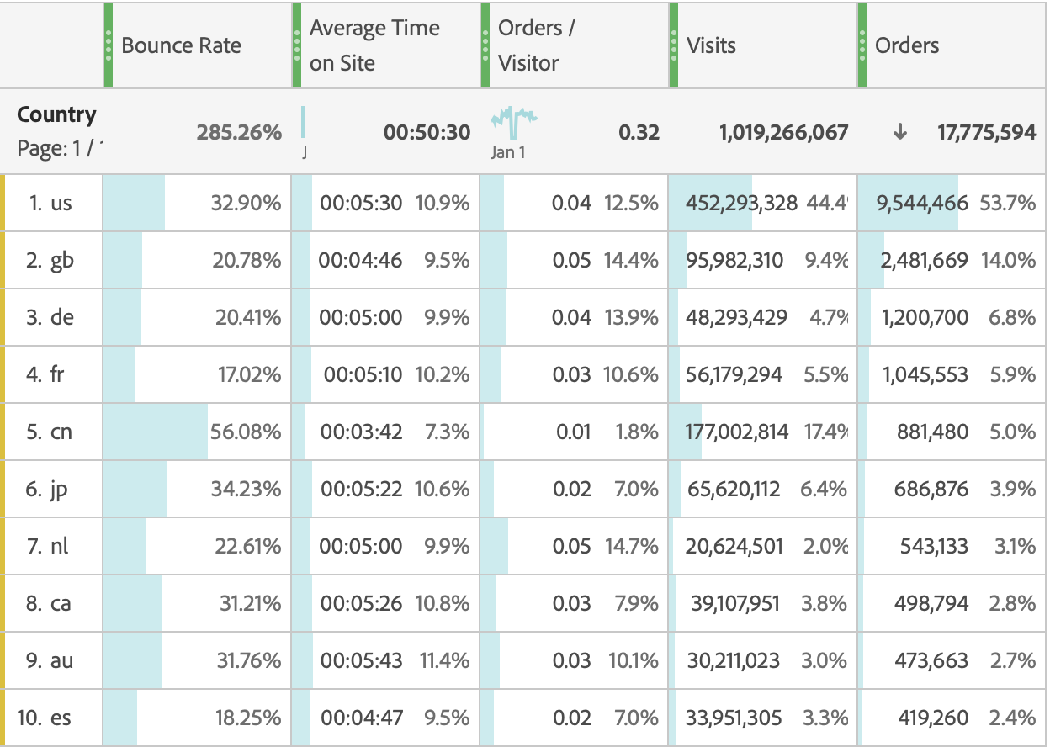
Revenue missout: Nike China’s website has 80% less orders/visitor than the overall average.
Hypothesis: If we could lower bounce rates of incoming traffic, we could increase orders.
So why does incoming traffic leave?
China stands out amongst the top 5 largest markets for Nike (by # of orders):
79.2% less order per visit than the overall average
23.4% shorter avg. time spent on site than overall average
1.75x higher bounce rate than overall average
Notes:
This is our problem space identification.
Revenue miss-out because China visibly has some lower purchasing behavior and higher bounce behavior.

Slide 5
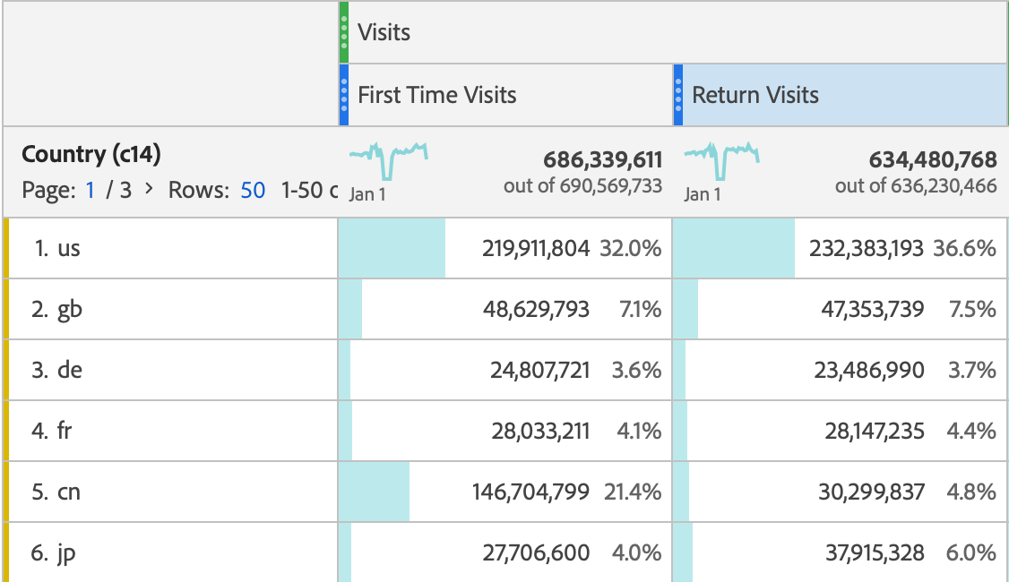
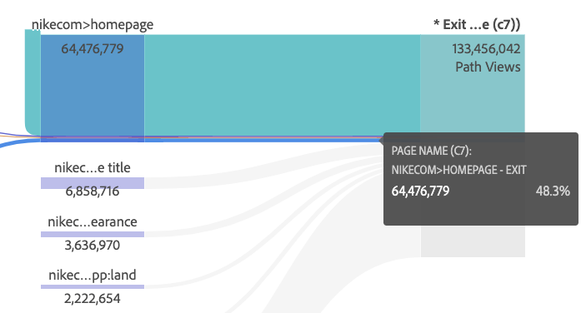
Nike China loses potential revenue due to 1st time visitors bouncing on the homepage at higher than average rates.
1st time visits dominate in China
48% of 1st time visits exit on homepage
Compared to other biggest markets for Nike China’s 1st time traffic makes up ~80% of all traffic, compared to about 50% in other big markets.
48.3% of 1st time visits exit nike.com on homepage, compared to 7.9% in the US, 4.2% in GB, 5.2% in DE.
Notes:
On the previous page we saw increased visits and higher bounce rates, and digging in further on this we now see much of these are first time visits.
First time visits in China hold a much higher percent of total visits compared to other top market countries
We’ll visit how this compares to other countries in our Analytics dashboard

Slide 6

Why are there so many more 1st time visits than in other countries?
And why do 1st time visits exit on the homepage at higher rates?
Notes:
At this point, we ask ourselves these two questions:
Annais will talk through our process of trying to answering these.

Slide 7
1st time visit traffic may be coming in due to increase marketing spend in China.
Yet, 1st time visit traffic is bouncing at much higher rates - this is the “wrong” traffic
So how do we bring in the “right” traffic?
Initial research findings
Validation required
We conducted initial user interviews with Nike users in China:
Nike has been pushing the WeChat integration in China strongly since COVID.
Assumption: WeChat traffic is seen as web traffic.
Hypothesis: Increase marketing spend on WeChat as channel is driving 1st time visits.
Next step: Interview with marketing team responsible for China required for validation of hypothesis and assumption.
Notes:
2020 Nike’s reorganization has prioritized China market (China market directly report to Nike global) due to it’s large sale size during the Covid
Nike Wechat mini program sharing the same database as Wechat, make it easy to track user habits, logins, payments and their sharing activities.
Nike’s Wechat official account and mini program integration has created a holistic experience for Nike members; however, first-time users and non-members lack incentives to stick around, it might suggests the higher bouncing rate on Nike’s homepage.

Slide 8
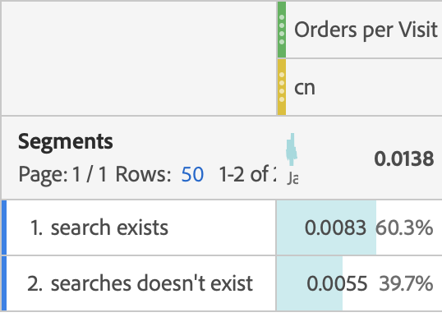
We are driving in traffic w/o intent to purchase when reaching nike.com - the “wrong” traffic
China with low % of “search visits”
In China “Search visits” have higher order/visit
Search on nike.com is a proxy for “intent” to purchase a specific product
So how do we bring in visitors with an “intent” to purchase?
The ratio of first time visits searching vs. not searching is
1 : 13
For other top 5 markets this ratio is only about 1:3
For return visits this is 1:3 for China and about 1:2 for top 5 markets (except US)
Notes:
China search visits tend to order more

Slide 9
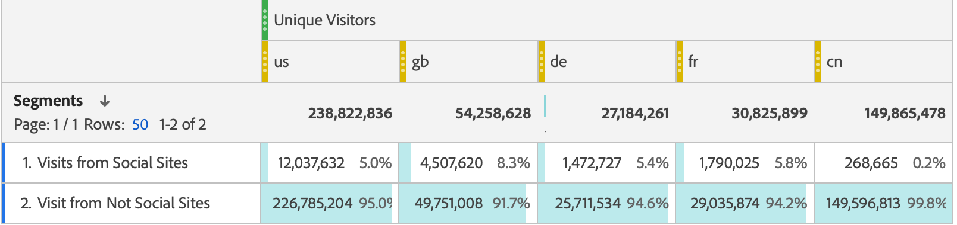
China under-utilizes social media marketing channels to drive traffic
Going back: How do we create intent?
Hypothesis: Social media mktg. primes customers with spec. prod. ideas - creating an “intent to purchase”
China is underutilizing social med. mktg channels compared to top 5 markets
China has different social media marketing channels and user behaviors than others in the top 5 markets (e.g. China has no Facebook or Instagram; live-streaming and influencers are more popular in China)
Notes:
Note: To validate and further discuss this finding, we would need to interview Nike’s China marketing team.

Slide 10

Let’s recap
For this case study, “right” traffic is a visitor with an “intent to purchase” - visitor primed w/ product idea prior to arrival
Hypothesis I: Social media marketing primes customers with an “intent to purchase”
Hypothesis II: Primed visitors have a higher purchase likelihood

Slide 11

Nike China should invest into priming customers with product ideas via social media marketing.
Problem
Recommendation
Next steps
Revenue missout: 1st time traffic without primed purchase intent
Presumably due to investing mktg budget into WeChat ineffectively
Reallocation of marketing budget to social media channels: Make visitors intent-driven through priming w/ product idea
Specifically we suggest:
TikTok for live streaming ecommerce.
Little Red Book’s official store and influencers.
Speak to China’s marketing team
Test biggest assumptions regarding:
Coding of social media channels in China
Investment into marketing via WeChat for driving 1st time visits
Notes:
Reasons for each recommendation:
TikTok can be harnessed for live streaming ecommerce and event promotion.
Nike currently does not have a Little Red Book official storefront (only distributors) despite having featured influencers there. An official storefront would provide a seamless purchasing experience for customers.
Our own Market research finding:
Nike has shifted away from Alibaba and T-Mao to push their own Wechat integration, such as the mini program and official media account. This makes sense due to Nike’s inability to “know” their customers on these types of eCommerce platforms.
Additionally, the ideal user groups of these social media platforms (being Gen-z females and younger generations) is the same ideal purchasing group for Nike. Investing in intent-driven traffic from these platforms would provide Nike opportunity for engagement with an already-likely consumer.

